Slide 1

DnA Team Tech Talk
Speaker: Nguyen Thi Binh An

Slide 2
CONTENTS
Database Overview
Types of Databases
Dive into SQL

Slide 3
Database Overview

Slide 4

DATABASE DEFINITION
An organized collection of data .
Allows users to store, manage, retrieve, manipulate information efficiently.
ROLE OF DATABASE
Backbone of the application.
Data management.
Scalability, Security, Backup…

Slide 5
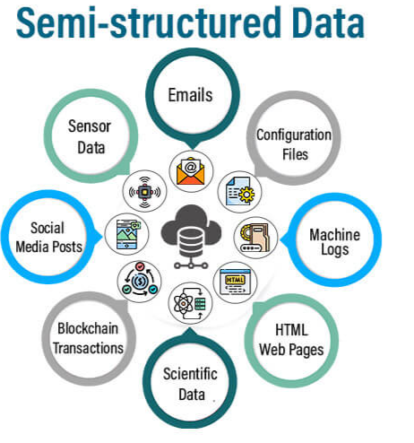
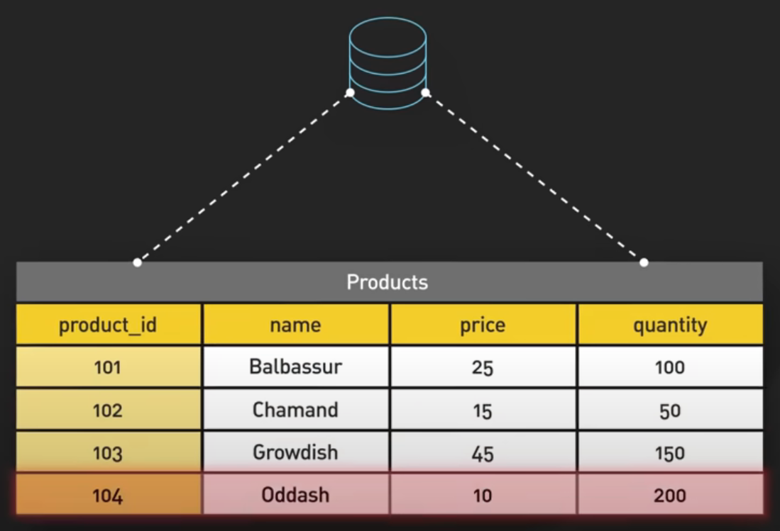


Structured
Un-structured

Slide 6
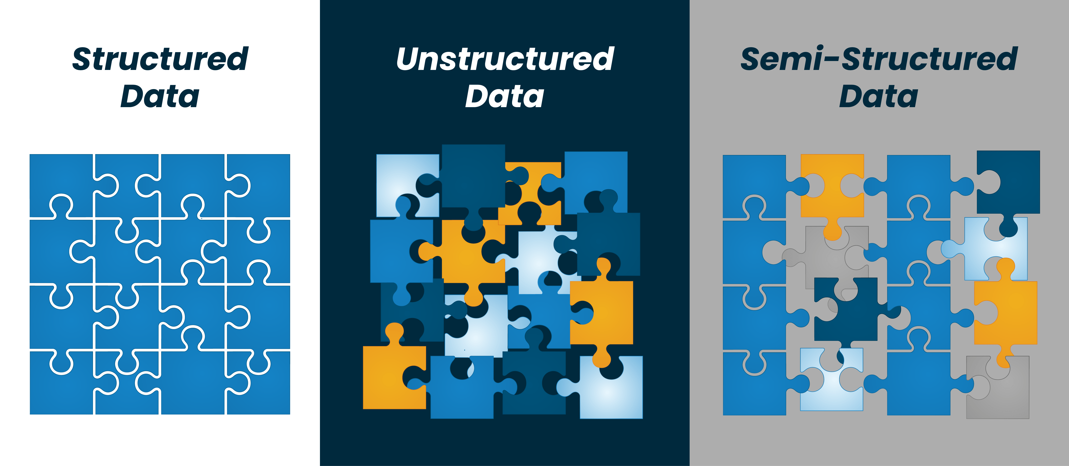

Slide 7
VOLUME
Amount or size of data that organization are dealing.
VELOCITY
Speed at which new data is generated, collected, processed
VARIETY
Different types, structures, and sources of data

Slide 8
Types of Databases

Slide 9
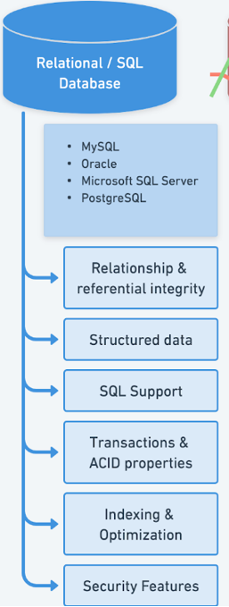
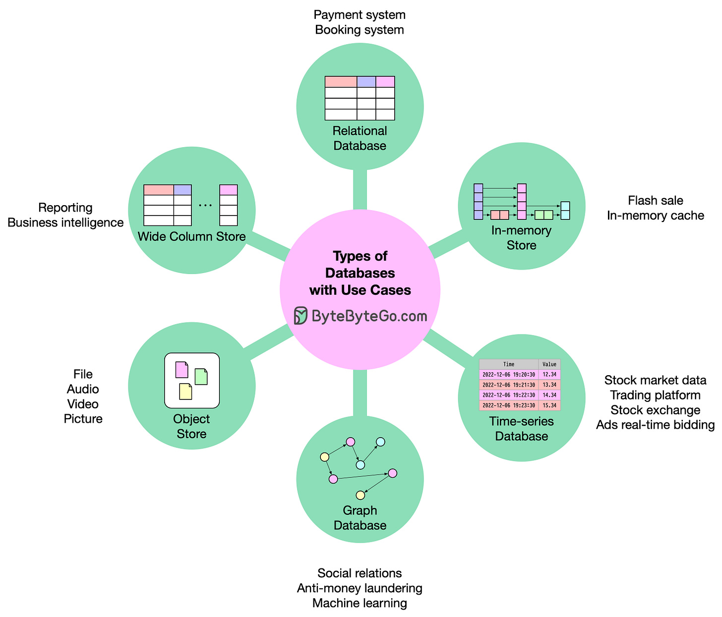

Slide 10
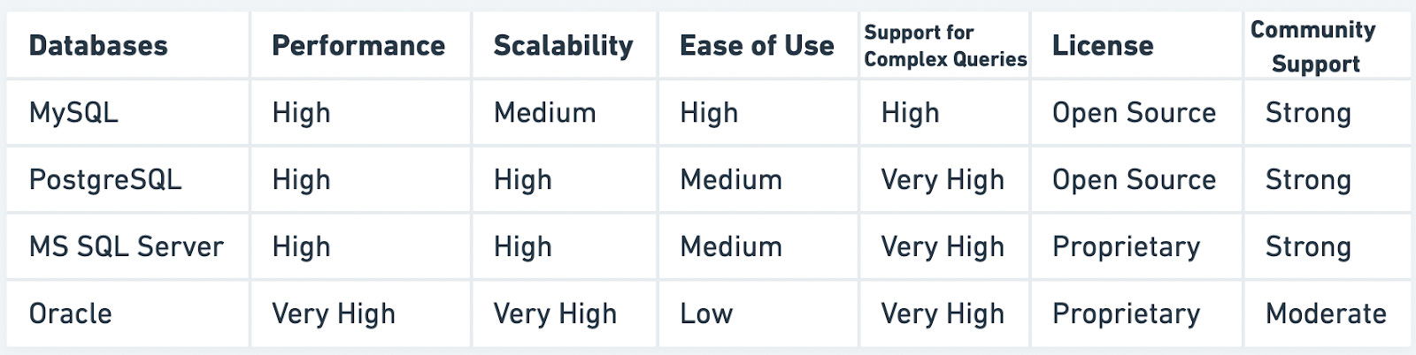

Slide 11
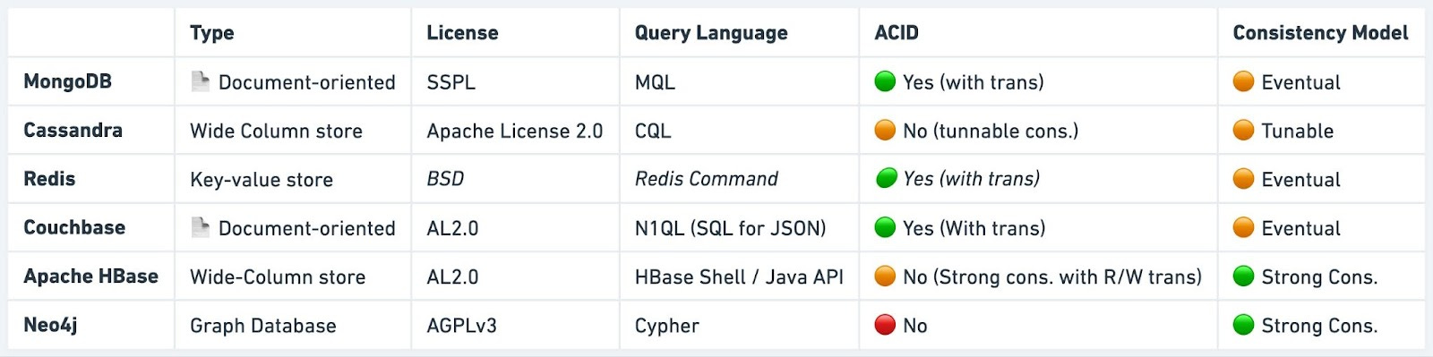

Slide 12
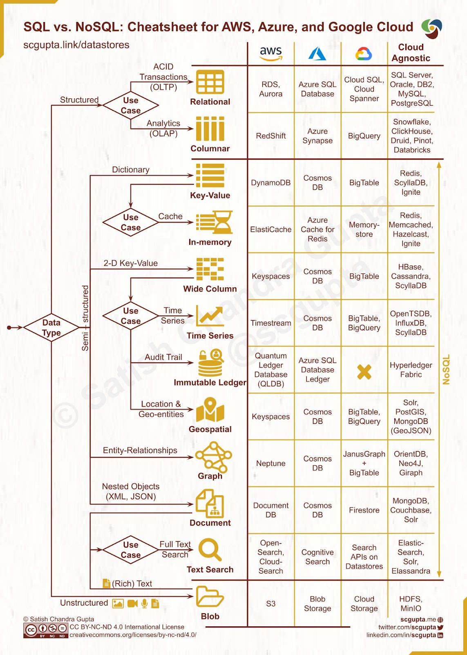

Slide 13
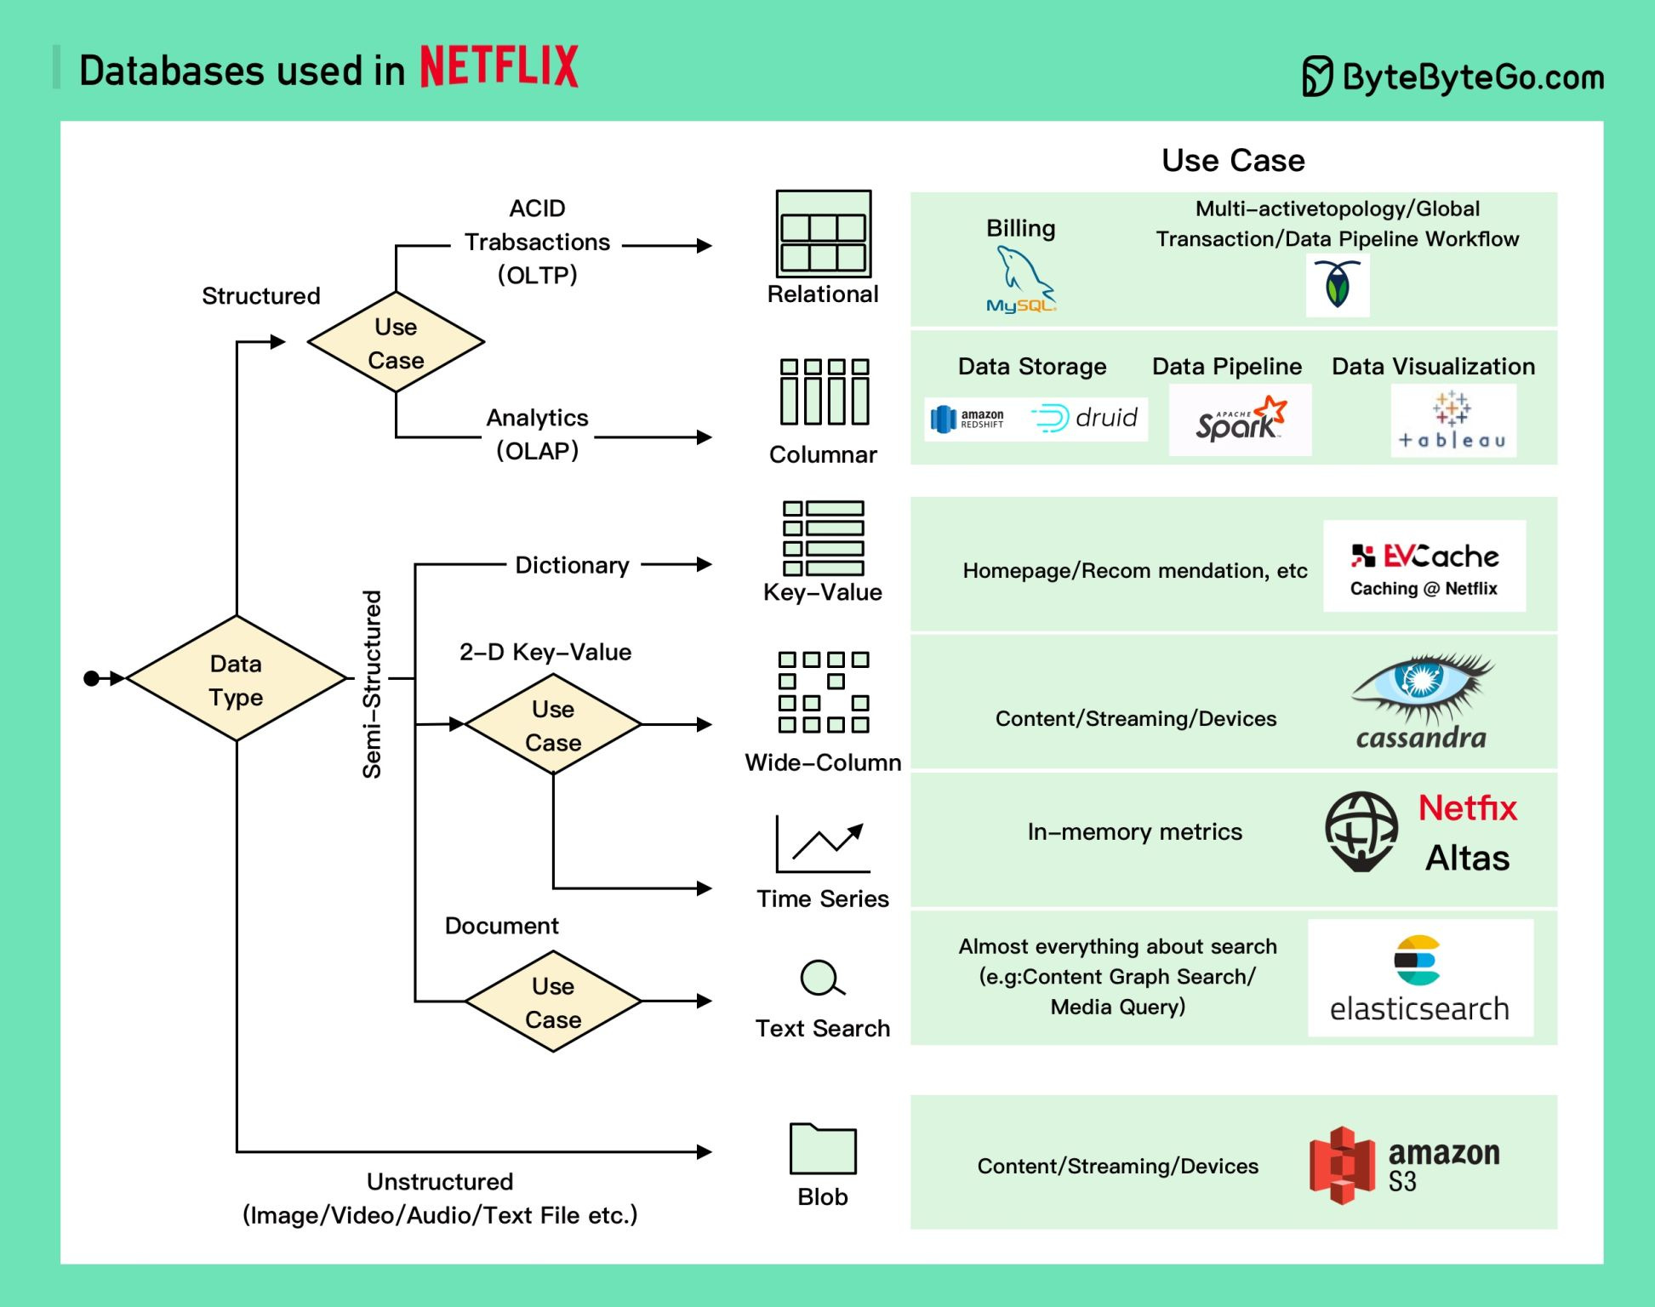

Slide 14
Dive into SQL

Slide 15
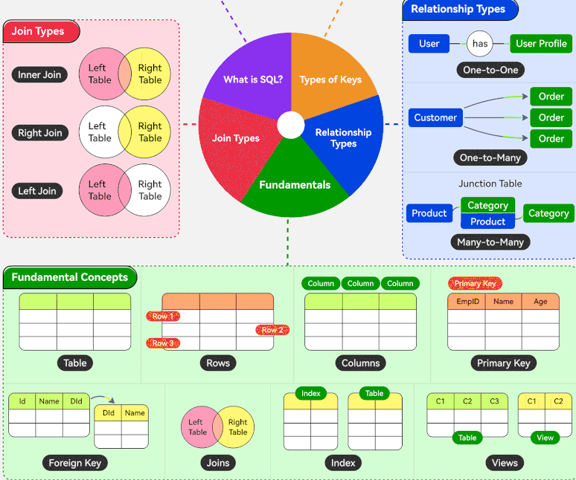

Slide 16
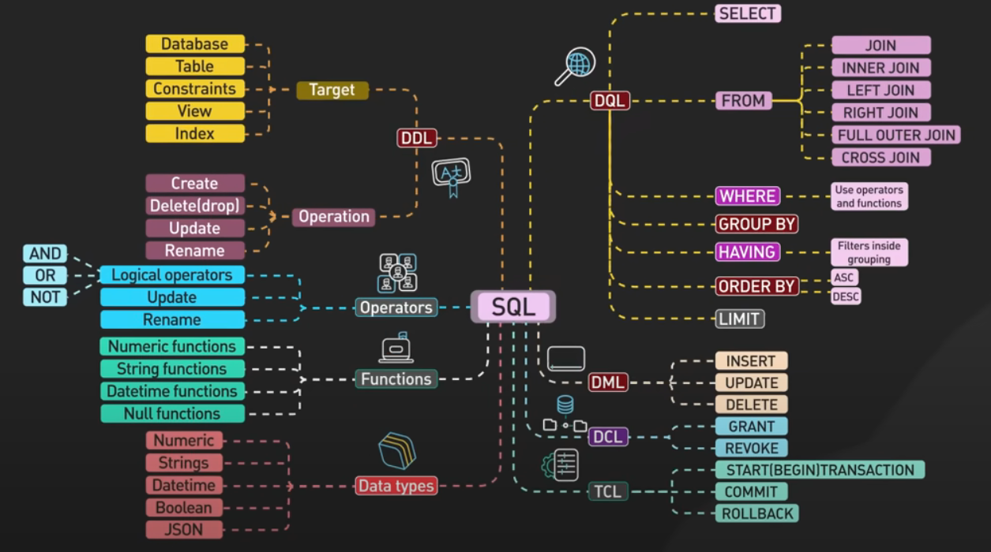

Slide 17
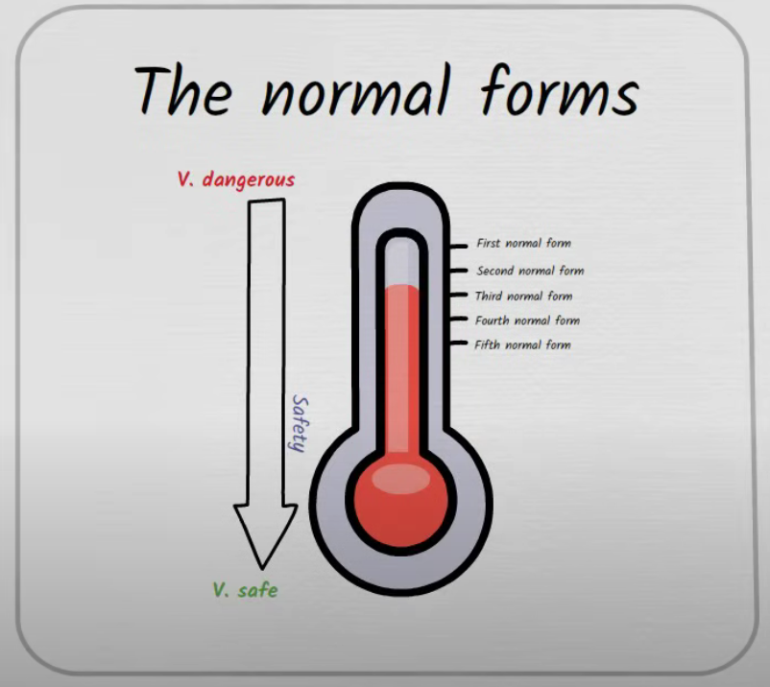
Database Normalization

Slide 18
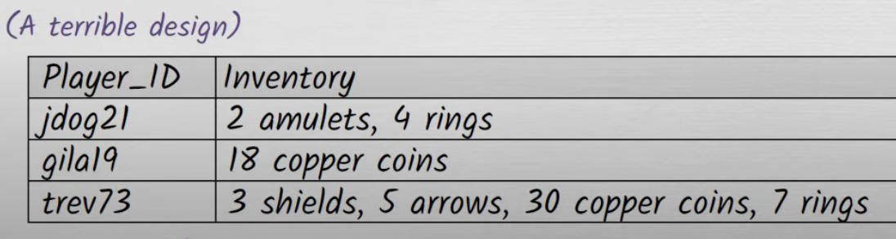
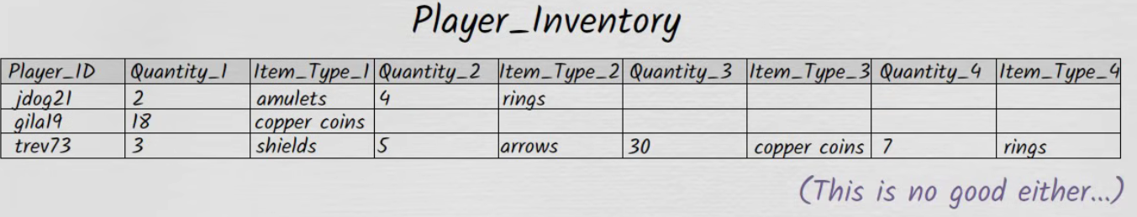
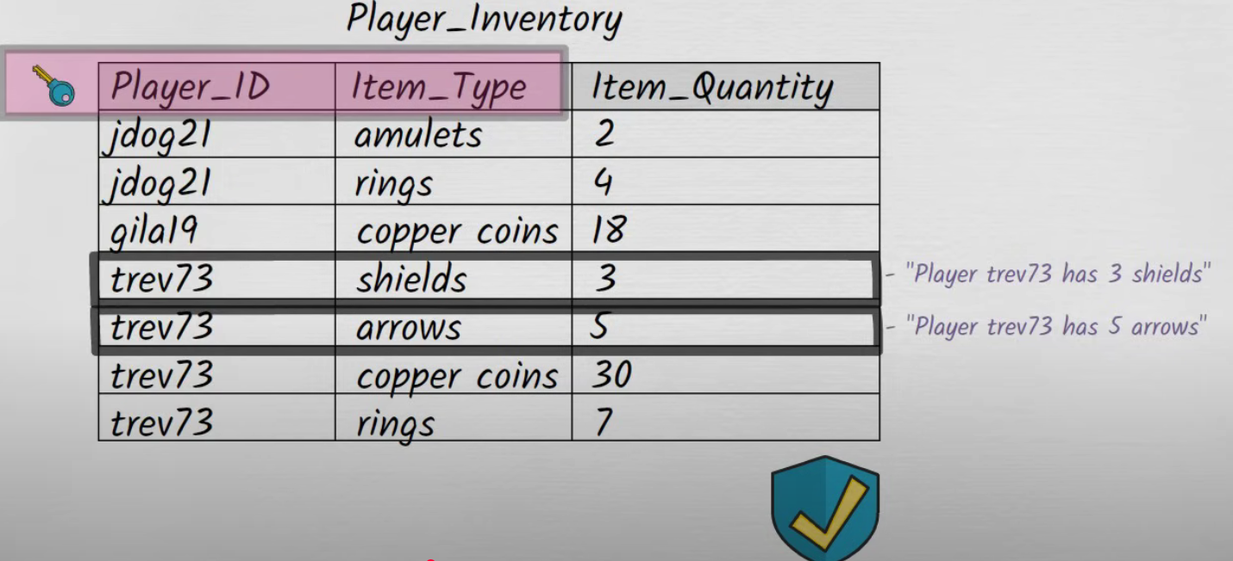
1NF

Slide 19
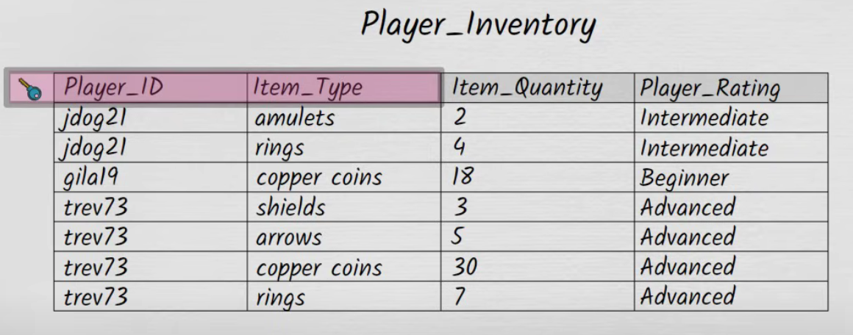
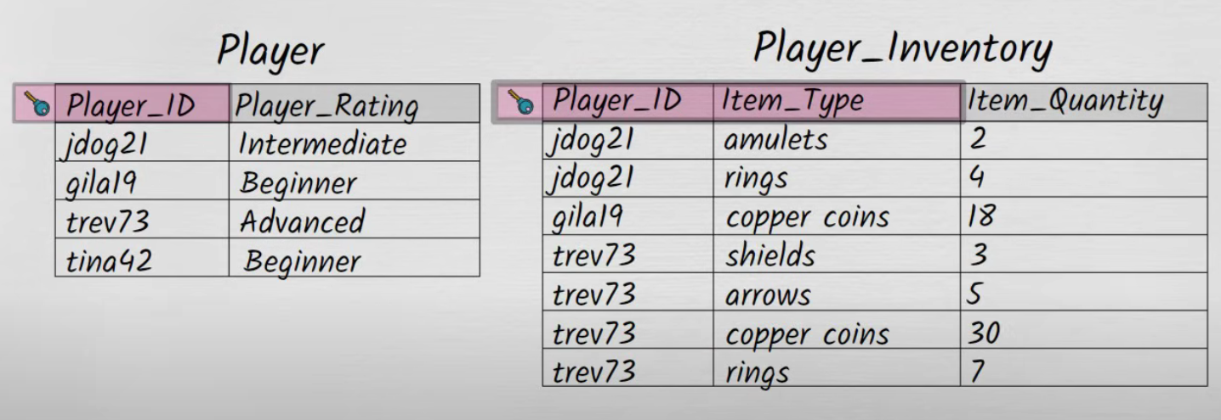
2NF

Slide 20
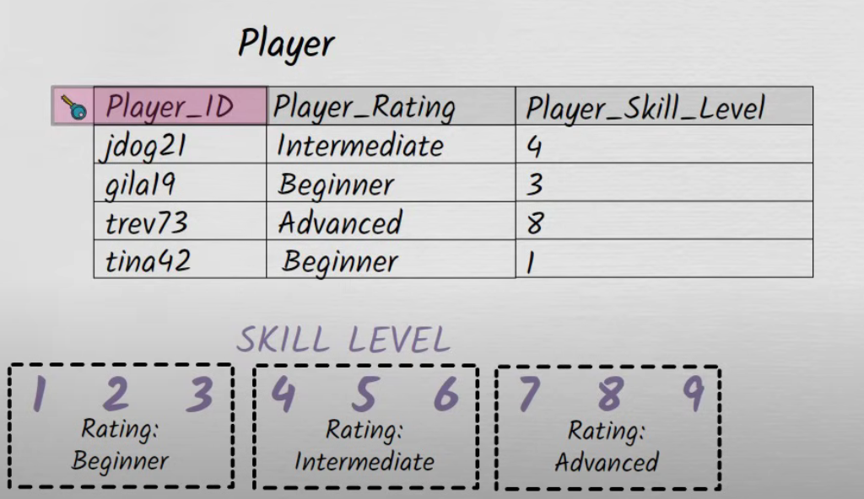
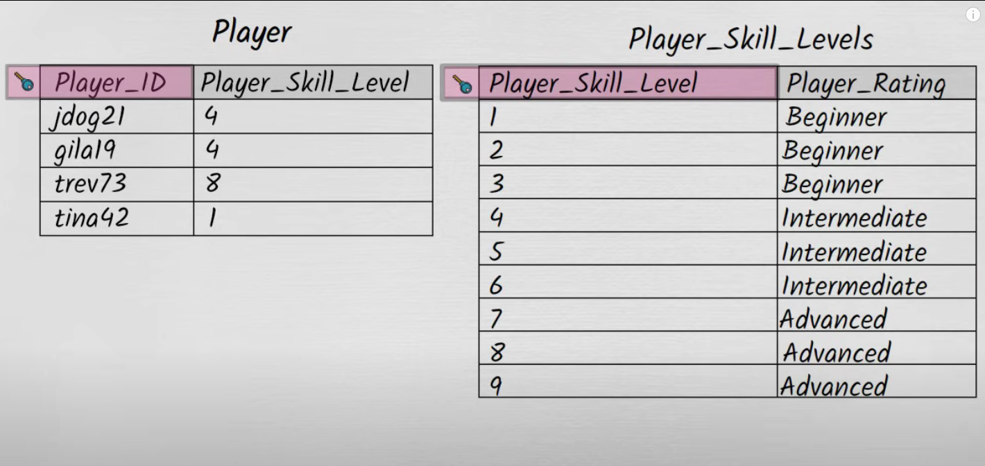
3NF

Slide 21
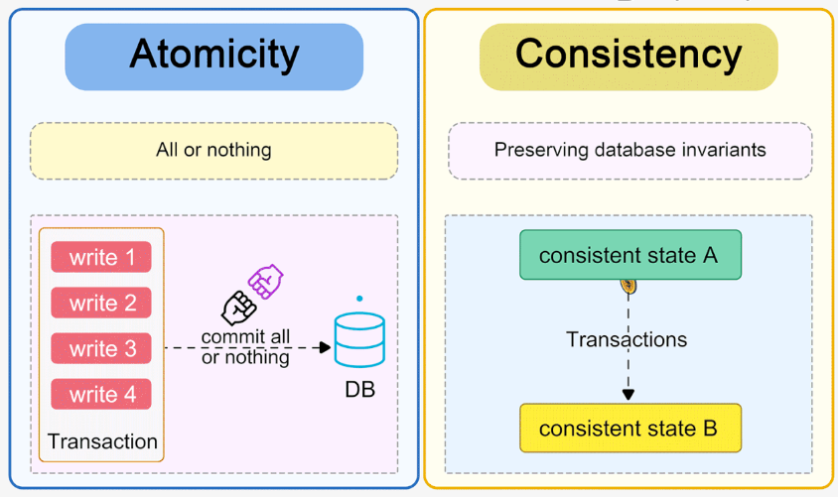

Slide 22
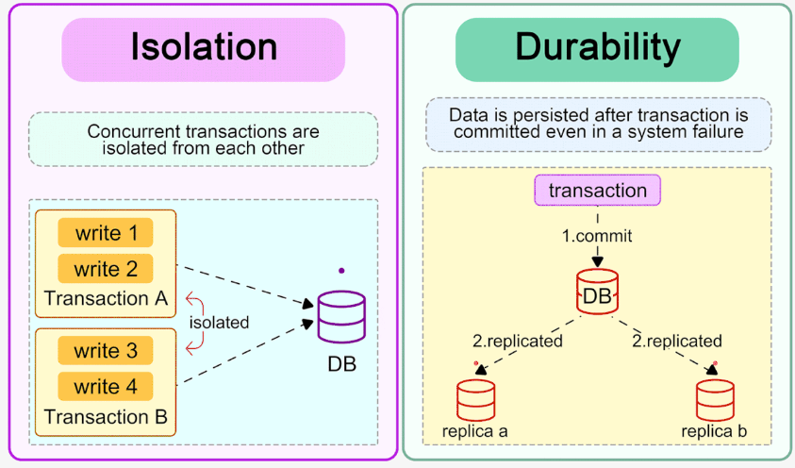

Slide 23
SQL Execution Order

Slide 24
Indexing

Slide 25
Partitioning

Slide 26
Sharding

Slide 27
Concurrency Control

Slide 28
Discusions

Slide 30
Thank you !

